Slide 1
Forma inversa segundo teorema de traslación M.Sc. Norberto Oviedo Ugalde

Slide 2
Teorema forma inversa del segundo teorema de traslación
Sea y entonces la Transformada Inversa de Laplace de
$a>0$
$${\text{L}}^{ −1}\left\{F (s) \right\}=f(t)$$
$${\text{L}}^{ −1}\left\{e^{−a.s}F (s) \right\}$$
$${\text{L}}^{ −1}\left\{e^{−a.s}F (s) \right\}$$
$$H(t−a)$$
$${ \text{L}}^{ −1}\left\{F(s)\right\}$$
$$=$$
t$−a$
$$={H\left(t−a\right)}^{}f(t)$$
t$−a$
$$={H\left(t−a\right)}^{}f(t−a)$$

Slide 3
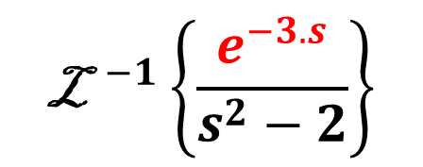
$${\text{L}}^{ −1}\left\{e^{−a.s}F (s) \right\}$$
$${\text{L}}^{ −1}\left\{e^{−a.s}F (s) \right\}$$
$$=H(t−a)$$
$${ \text{L}}^{ −1}\left\{F(s)\right\}$$
t$−a$
Ejemplo1
$${\text{L}}^{ }\left\{senh(at) \right\}=\frac{a}{s^{2}−a^{2}}$$
$${\text{L}}^{ −1}\left\{\frac{e^{−3.s}}{s^{2}−2}\right\}$$
$${\text{=} \text{L}}^{ −1}\left\{e^{−3.s}. \frac{1}{s^{2}−2}\right\}$$
$${\text{=} \text{L}}^{ −1}\left\{e^{−3.s}. \frac{1}{s^{2}−2}\right\}$$
$${=H(t−3)\text{L}}^{ −1}\left\{\frac{1}{s^{2}−{\left(\sqrt{2}\right)}^{2}} \right\}$$
t$−3$
$${=H\left(t−3\right)[\frac{1}{\sqrt{2}}senh\left(\sqrt{2} t\right) ]}^{}$$
t$−3$
$${=H\left(t−3\right)\frac{1}{\sqrt{2}}senh\left(\sqrt{2} (t−3)\right) }^{}$$

Slide 4
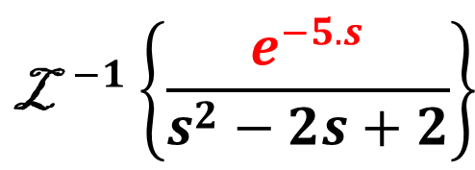
$${\text{L}}^{ −1}\left\{e^{−a.s}F (s) \right\}$$
$${\text{L}}^{ −1}\left\{e^{−a.s}F (s) \right\}$$
$$=H(t−a)$$
$${ \text{L}}^{ −1}\left\{F(s)\right\}$$
t$−a$
Ejemplo 2
$${\text{L}}^{ −1}\left\{\frac{e^{−5.s}}{s^{2}−2s+2}\right\}$$
$${\text{L}}^{ }\left\{sen(at) \right\}=\frac{a}{s^{2}+a^{2}}$$
$${\text{=} \text{L}}^{ −1}\left\{e^{−5.s}. \frac{1}{{\left(s−1\right)}^{2}+1}\right\}$$
$${\text{=} \text{L}}^{ −1}\left\{e^{−5.s}. \frac{1}{{\left(s−1\right)}^{2}+1}\right\}$$
$${=H(t−5)\text{L}}^{ −1}\left\{\frac{1}{{\left(s−1\right)}^{2}+1} \right\}$$
t$−5$
$${=H(t−5)\text{L}}^{ −1}\left\{\frac{1}{s^{2}+1} \right\}$$
s$−1$
t$−5$
$${=H\left(t−5\right){[e}^{t}sen\left(t\right) ]}^{}$$
$${=H\left(t−5\right){[e}^{t−5}sen(t−5)]}^{}$$
t$−5$

Slide 5
Vicerrectoría de Docencia
CEDA-TEC Digital
Proyecto de Virtualización 2018
Ecuaciones Diferenciales
M.Sc. Norberto Oviedo Ugalde - Profesor
Ing. Luis Carlos Guzmán Arias - Coordinador de Diseño

