Slide 1
Forma inversa teorema de convolución M.Sc. Norberto Oviedo Ugalde

Slide 2
Teorema forma inversa del teorema de convolución
Sea entonces la Transformada Inversa de Laplace de
${\text{L}}^{ −1}\left\{F (s) \right\}=f(t)$,
$${\text{L}}^{ −1}\left\{G (s) \right\}=g(t)$$
$${\text{L}}^{ −1}\left\{F \left(s\right). G(s)\right\}$$
$$=$$
$${\text{L}}^{ −1}\left\{F \left(s\right))\right\}$$
$$∗$$
$${\text{L}}^{ −1}\left\{G(s)\right\}$$
$$=$$
$$f(t)$$
$$∗$$
$$g(t)$$
$$\int_{0}^{t}{f\left(t−u\right)g\left(u\right)du}$$
$$\int_{0}^{t}{f\left(u\right)g\left(t−u\right)du}$$
$$=$$

Slide 3
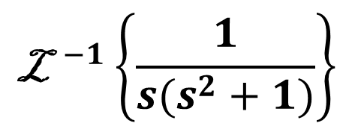



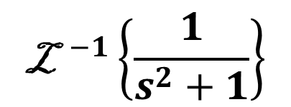
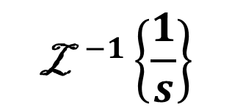
$${\text{L}}^{ −1}\left\{F \left(s\right). G(s)\right\}$$
$$=$$
$${\text{L}}^{ −1}\left\{F \left(s\right))\right\}$$
$$∗$$
$${\text{L}}^{ −1}\left\{G(s)\right\}$$
Ejemplo1
$$F \left(s\right)$$
$$G \left(s\right)$$
$${\text{L}}^{ −1}\left\{\frac{1}{{s(s}^{2}+1)}\right\}$$
$${\text{L}}^{ −1}\left\{ \frac{1}{s} . \frac{1}{{(s}^{2}+1)} \right\}$$
$${\text{L}}^{ −1}\left\{\frac{1}{s}\right\}$$
$${\text{L}}^{ −1}\left\{\frac{1}{s^{2}+1}\right\}$$
$$=$$
$$=$$
$$∗$$
$$f\left(u\right)=sen\left(u\right)$$
$$1$$
$$sen(t)$$
$$=$$
$$∗$$
$${\text{L}}^{ }\left\{1 \right\}=\frac{1}{s}$$
$${\text{L}}^{ }\left\{sen(at) \right\}=\frac{a}{s^{2}+a^{2}}$$
$$g\left(t−u\right)=1$$
$$\int_{0}^{t}{1.sen(u)du}$$
$$=$$
$$=$$
$$1−cos(t)$$

Slide 4

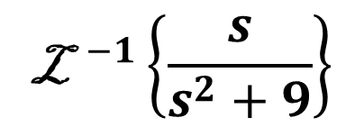
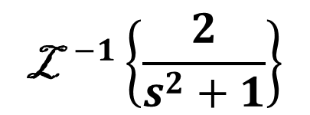
$${\text{L}}^{ −1}\left\{F \left(s\right). G(s)\right\}$$
$$=$$
$${\text{L}}^{ −1}\left\{F \left(s\right))\right\}$$
$$∗$$
$${\text{L}}^{ −1}\left\{G(s)\right\}$$
Ejemplo 2
$$F \left(s\right)$$
$$G \left(s\right)$$
$$f\left(u\right)=sen\left(u\right)$$
$${\text{L}}^{ }\left\{sen(at) \right\}=\frac{a}{s^{2}+a^{2}}$$
$${\text{L}}^{ }\left\{cos(at) \right\}=\frac{s}{s^{2}+a^{2}}$$
$${\text{L}}^{ −1}\left\{\frac{2s}{{(s}^{2}+1)\left(s^{2}+9\right)}\right\}$$
$${\text{L}}^{ −1}\left\{ \frac{2}{s^{2}+1} . \frac{s}{s^{2}+9} \right\}$$
$$g\left(t−u\right)=cos(3(t−u))$$
$$=$$
$${\text{L}}^{ −1}\left\{\frac{2}{s^{2}+1}\right\}$$
$${\text{L}}^{ −1}\left\{\frac{s}{s^{2}+9}\right\}$$
$$=$$
$$∗$$
$$=$$
$$2 sen(t)$$
$$∗$$
$$cos(3t)$$
$$\int_{0}^{t}{2.sen\left(u\right)cos(3\left(t−u\right))du}$$
$$\int_{0}^{t}{2.sen\left(u\right)cos(3t−3u)du}$$
$$\int_{0}^{t}{sen\left(3t−2u\right)+sen(4u−3t)du}$$
$$=$$
$$=$$
$$[\frac{1}{2}cos\left(3t−2u\right)−\frac{1}{4}cos\left(4u−3t\right)]$$
$$\frac{cos\left(t\right)}{4}−\frac{cos\left(3t\right)}{4}$$
$$[\frac{1}{2}cos\left(3t−2u\right)−\frac{1}{4}cos\left(4u−3t\right)]$$
$$\frac{cos\left(t\right)}{2}−\frac{cos\left(3t\right)}{2}−\frac{cos\left(t\right)}{4}+\frac{cos\left(3t\right)}{4}$$
$$t$$
$$=$$
$$t$$
$$=$$
$$0$$
$$0$$
$$2senA.cosB=sen\left(A+B\right)+sen(A−B)$$

Slide 5
Vicerrectoría de Docencia
CEDA-TEC Digital
Proyecto de Virtualización 2018
Ecuaciones Diferenciales
M.Sc. Norberto Oviedo Ugalde - Profesor
Ing. Luis Carlos Guzmán Arias - Coordinador de Diseño

