Slide 1
Ecuación diferencial lineal mediante operadores M.Sc. Norberto Oviedo Ugalde

Slide 2
Considere :
cuya solución de la ecuación homogénea viene dada por
Determine la forma de la solución particular de 1.
$$φ\left(D\right)y=12 x+4 e^{\frac{x}{2}}−e^{−x} cos (2x)$$
1
$$y_{H}=C_{1}+C_{2}e^{\frac{x}{2}}+C_{3} xe^{\frac{x}{2}} −e^{−x}[\left(C_{4}x+C_{5}\right) cos \left(2x\right)+\left(C_{6}x+C_{7}\right)sen (2x)]$$
2

Slide 3

1
$$φ\left(D\right)y=12 x+4 e^{\frac{x}{2}}−e^{−x} cos (2x)$$
2
$$y_{H}=C_{1}+C_{2}e^{\frac{x}{2}}+C_{3} xe^{\frac{x}{2}} −e^{−x}[\left(C_{4}x+C_{5}\right) cos \left(2x\right)+\left(C_{6}x+C_{7}\right)sen (2x)]$$
Solución
Para hallar $φ\left(D\right)$en 1 se recurre a la solución $y_{H}$ en donde:
$${\left(D−\frac{1}{2}\right)}^{2}$$
$$D$$
$${(D^{2}+2D+5)}^{2}$$
$$=φ\left(D\right)$$
3
$$⇒\left(D{\left(D−\frac{1}{2}\right)}^{2}{\left(D^{2}+2D+5\right)}^{2}\right)y=12 x+4 e^{\frac{x}{2}}−e^{−x} cos (2x)$$

Slide 4

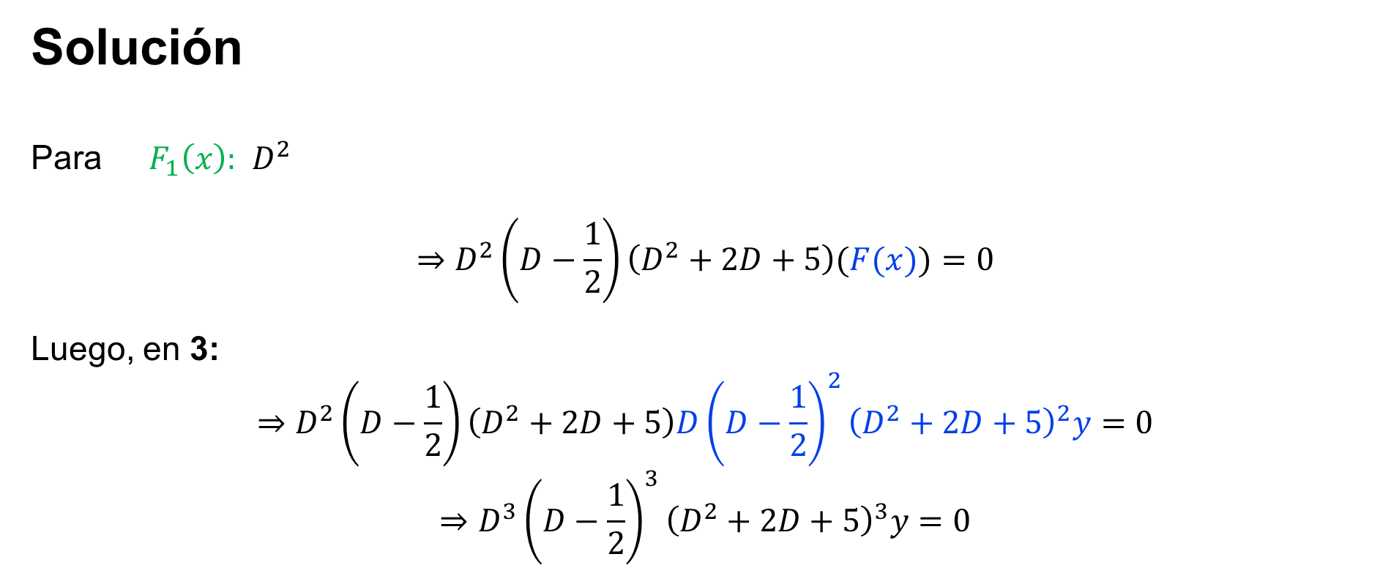
$$F(x)$$
3
$$\left(D{\left(D−\frac{1}{2}\right)}^{2}{\left(D^{2}+2D+5\right)}^{2}\right)y=12 x+4 e^{\frac{x}{2}}−e^{−x} cos (2x)$$
$$F_{1}(x)$$
$$F_{2}(x)$$
$$F_{3}(x)$$
Solución
Para $F_{1}\left(x\right):$ $D^{2}$
$$⇒D^{2}\left(D−\frac{1}{2}\right)\left(D^{2}+2D+5\right)(F(x))=0$$
Luego, en 3:
$$⇒D^{2}\left(D−\frac{1}{2}\right)\left(D^{2}+2D+5\right)D{\left(D−\frac{1}{2}\right)}^{2}{\left(D^{2}+2D+5\right)}^{2}y=0$$
$$⇒D^{3}{\left(D−\frac{1}{2}\right)}^{3}{\left(D^{2}+2D+5\right)}^{3}y=0$$
$$F_{2}\left(x\right):D−\frac{1}{2}$$
$$F_{3}\left(x\right): D^{2}+2D+5$$

Slide 5
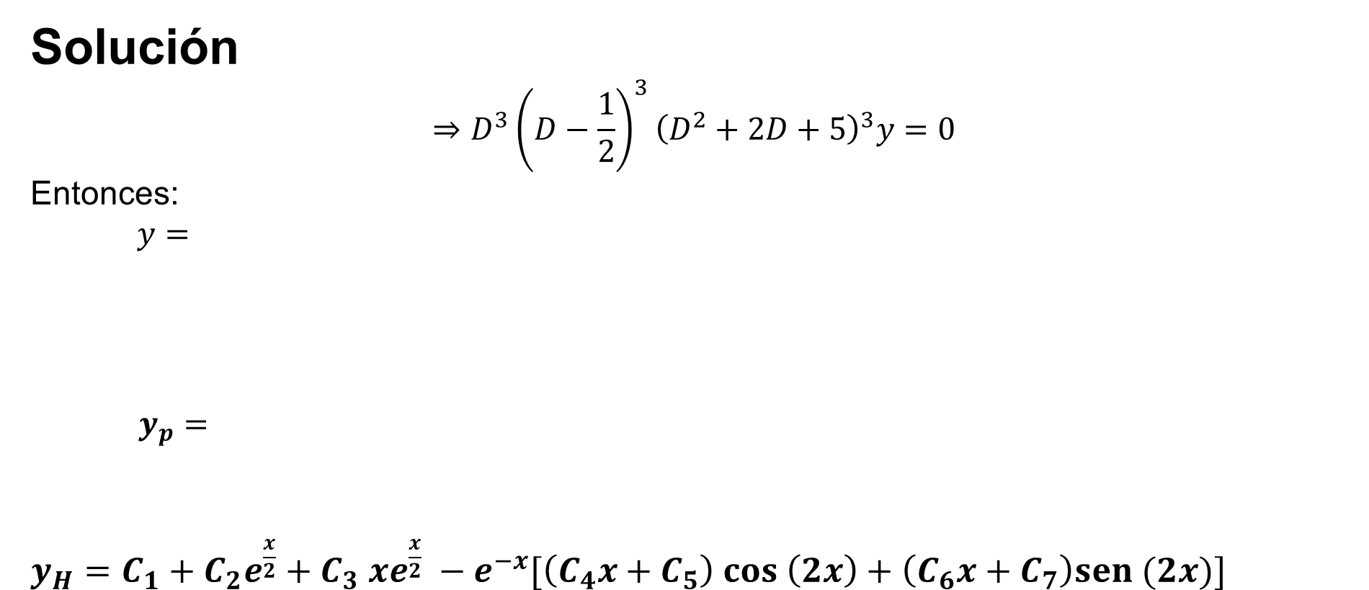

$$F(x)$$
3
$$\left(D{\left(D−\frac{1}{2}\right)}^{2}{\left(D^{2}+2D+5\right)}^{2}\right)y=12 x+4 e^{\frac{x}{2}}−e^{−x} cos (2x)$$
$$F_{1}(x)$$
$$F_{2}(x)$$
$$F_{3}(x)$$
Solución
$$⇒D^{3}{\left(D−\frac{1}{2}\right)}^{3}{\left(D^{2}+2D+5\right)}^{3}y=0$$
Entonces:
$$y=$$
$y_{p}=$
$y_{H}=C_{1}+C_{2}e^{\frac{x}{2}}+C_{3} xe^{\frac{x}{2}} −e^{−x}[\left(C_{4}x+C_{5}\right) cos \left(2x\right)+\left(C_{6}x+C_{7}\right)sen (2x)]$
$$+ e^{\frac{x}{2}}\left(Ex^{2}+Fx+G\right)$$
$$A+Bx+{Cx}^{2}$$
$$+ e^{−x}((Hx^{2}+Ix+J)\cos\left(2x\right)+(Kx^{2}+Lx+M ) sen(2x))$$
$$Bx+{Cx}^{2}$$
$$+ {Ex^{2}e}^{\frac{x}{2}}$$
$$+ {x^{2}e}^{−x}(H\cos\left(2x\right)+K sen(2x))$$
$$C_{2}e^{\frac{x}{2}}$$
$$C_{3}{ xe}^{\frac{x}{2}}$$
$${e^{−x}[\left(C_{4}x+C_{5}\right) cos \left(2x\right)}^{}$$
$$C_{1}$$
$${e^{−x}[ \left(C_{6}x+C_{7}\right)sen \left(2x\right)}^{}$$

Slide 6
Vicerrectoría de Docencia
CEDA-TEC Digital
Proyecto de Virtualización 2018
Ecuaciones Diferenciales
M.Sc. Norberto Oviedo Ugalde - Profesor
Bach. Dayana Calderón Prado - Estudiante Asistente
Ing. Luis Carlos Guzmán Arias - Coordinador de Diseño

