Slide 1
Transformada Inversa de Laplace M.Sc. Norberto Oviedo Ugalde

Slide 2
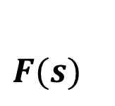
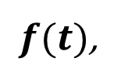
Transformada Inversa de Laplace
$F(s)$
$\text{L}\left\{f (t)\right\}=F(s)$
Si entonces la Transformada Inversa de Laplace de
$${\text{L}}^{ −1}\left\{F (s)\right\}$$
$f(t)$,
$${\text{L}}^{ −1}\left\{F (s)\right\}=f(t)$$
escrita es es decir,
Linealidad de Transformada Inversa de Laplace
Para contantes se cumple que
$${α \text{y} β}^{ }$$
$${\text{L}}^{ −1}\left\{α. F (s)±β. G (s)\right\}$$
$$=$$
$${α.\text{L}}^{ −1}\left\{F (s) \right\}$$
$${± β.\text{L}}^{ −1}\left\{ G (s)\right\}$$

Slide 3
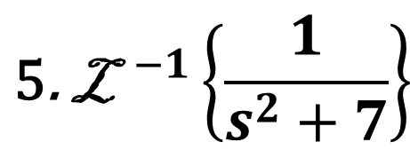
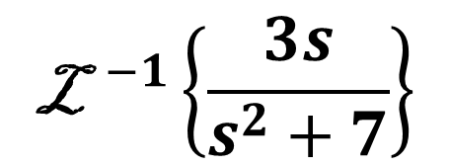
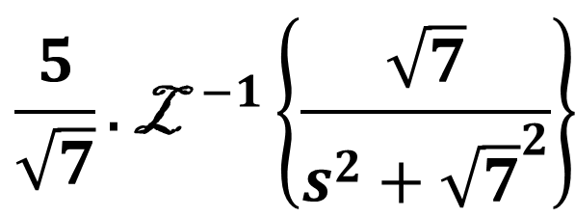
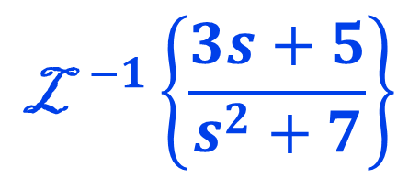
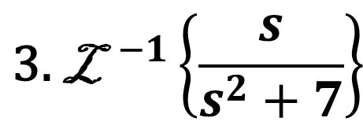
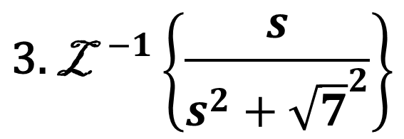
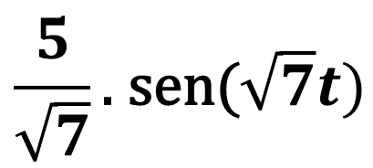
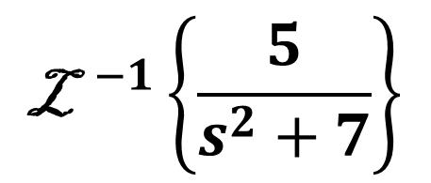
$${\text{L}}^{ −1}\left\{\frac{3s+5}{s^{2}+7}\right\}$$
$${\text{L}}^{ −1}\left\{\frac{3s}{s^{2}+7}\right\}$$
$${\text{L}}^{ −1}\left\{\frac{5}{s^{2}+7}\right\}$$
$$=$$
$$+$$
$${\text{3. }\text{L}}^{ −1}\left\{\frac{s}{s^{2}+7}\right\}$$
$${\text{5}\text{. }\text{L}}^{ −1}\left\{\frac{1}{s^{2}+7}\right\}$$
$$=$$
$$+$$
$${\text{3. }\text{L}}^{ −1}\left\{\frac{s}{s^{2}+{\sqrt{7}}^{2}}\right\}$$
$${\frac{5}{\sqrt{7}}\text{. }\text{L}}^{ −1}\left\{\frac{\sqrt{7}}{s^{2}+{\sqrt{7}}^{2}}\right\}$$
$$=$$
$$+$$
$${\frac{5}{\sqrt{7}}\text{. }\text{sen}\text{(}\sqrt{7}t) }^{ }$$
$$=$$
$${\text{3. }\text{cos}\text{(}\sqrt{7}t) }^{ }$$
$$+$$
$${\text{L}}^{ −1}\left\{\frac{s}{s^{2}+a^{2}}\right\}=cos(at)$$
$${{\text{L}}^{ −1}}^{ }\left\{\frac{a}{s^{2}+a^{2}}\right\}=sen(at)$$

Slide 4
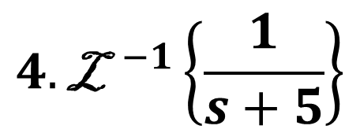
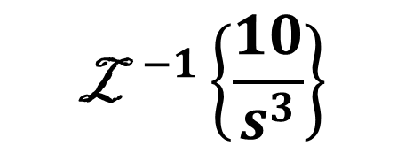
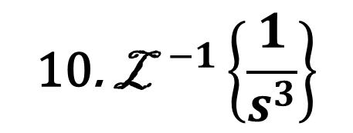
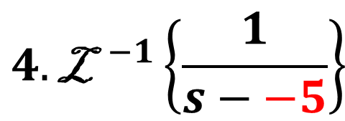
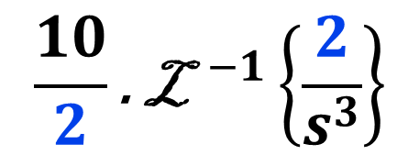
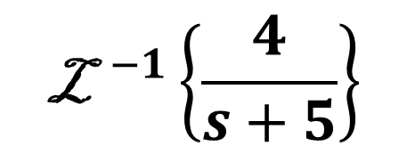
$${\text{L}}^{ −1}\left\{\frac{10}{s^{3}}−\frac{4}{s+5}\right\}$$
$${\text{L}}^{ −1}\left\{\frac{10}{s^{3}}\right\}$$
$${\text{L}}^{ −1}\left\{\frac{4}{s+5}\right\}$$
$$=$$
$$−$$
$${\text{10}\text{. }\text{L}}^{ −1}\left\{\frac{1}{s^{3}}\right\}$$
$$4. {\text{L}}^{ −1}\left\{\frac{1}{s+5}\right\}$$
$$=$$
$$−$$
$${\frac{10}{2}\text{. }\text{L}}^{ −1}\left\{\frac{2}{s^{3}}\right\}$$
$$4. {\text{L}}^{ −1}\left\{\frac{1}{s−−5}\right\}$$
$$=$$
$$−$$
$$=$$
$${\text{5}\text{.}t^{2} }^{ }$$
$$−$$
$${4.e^{−5t} }^{ }$$
$${\text{L}}^{ }\left\{t^{n}\right\}=\frac{n!}{s^{n+1}}$$
$${\text{L}}^{ }\left\{e^{at}\right\}=\frac{1}{s−a}$$

Slide 5
Vicerrectoría de Docencia
CEDA-TEC Digital
Proyecto de Virtualización 2018
Ecuaciones Diferenciales
M.Sc. Norberto Oviedo Ugalde - Profesor
Ing. Luis Carlos Guzmán Arias - Coordinador de Diseño

